Slide 1

MIS 281N
Data Management
Class 1: Course Overview & Motivation
Clint Tuttle
Senior Lecturer, The University of Texas at Austin
Brad Poynter
Software Engineer, Leader, Innovator, Problem Solver, Team Builder

Slide 2
Objectives
Introductions
Course Overview
Understand the importance of data and data management
Questions and discussion

Slide 3
Introductions

Slide 4
Getting in touch
Slack
All questions go here
Use channels
Pay it forward
Office hours (online on Zoom)
In class
Before or After class
FYI: Class ends at 5:50pm

Slide 5
Student Intros

Slide 6
Who are all of you?
Please navigate to the “UT Instapoll” under Module 1 in Canvas

Slide 7
Course Overview

Slide 8
Themes…
Data management is a critical business & technology skill for IT leaders
Technology is necessary but not sufficient without a thoughtful strategy, proper architecture, and effective policies.
Data architecture, governance, ethics, security, and privacy practices are critical
We need to harness relational (SQL) & non-relational technology (NoSQL) to enable strategy and operations
The rate of data captured in the world is growing exponentially – volume, velocity, variety, veracity, value

Slide 9
Teaching Environment…
Active learning (case discussions, breakout teams, hands-on work)
Collect feedback early, often, and adapt based on feedback
Focus on learning and not grade
Be on time, respect everyone (all our situations are unique & different)
Self-directed learning is critical

Slide 10
Quick Poll (on Instapoll)
In an analytics project, what percent of time is spent "managing" data?

Slide 11
Is data important?
Some people say data is the new oil… (i.e. “fuel”)
Others consider data to be “exhaust”…
Who is right?
What is the role of data management?

Slide 12
Is data important?
Strategy
Data, Analytics, & Intelligence
Operations
Technology

Slide 13
A key objective of this class is to produce data managers, not just data programmers

Slide 14
Course Overview
Objectives
Assessment
Understand importance and value of data management
Data Strategy, Ethics, and Risk
Review Modeling, DDL, & DML
Information Security and Data Control
Issues with RDBMS → New DBs
Data Warehouses, ETL, ROLAP
Data Architecture
Data Governance
Big Data, Distributed Data, and NoSQL
Choose your adventure in tech
Participation – 10%
Homework assignments – 30%
Midterm exam – 30%
Final group project – 30%

Slide 15
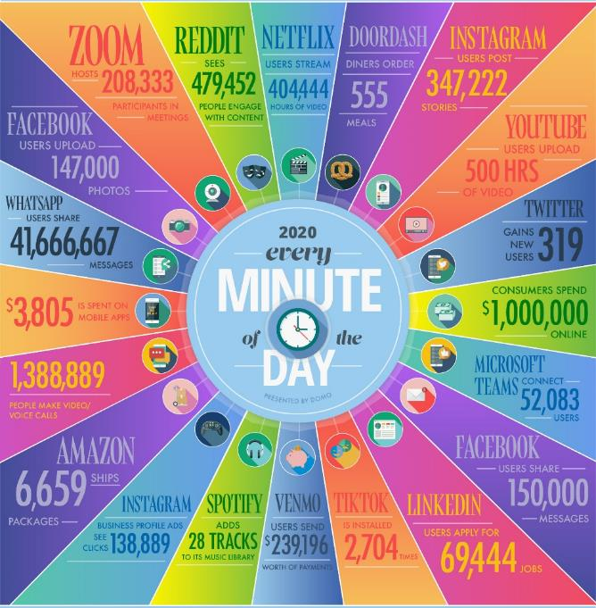
The pace of data growth is impressive
While this is an impressive amount of data, are there additional sources of data?
What can we say about the types of data being created?
https://www.domo.com/learn/data-never-sleeps-8

Slide 16

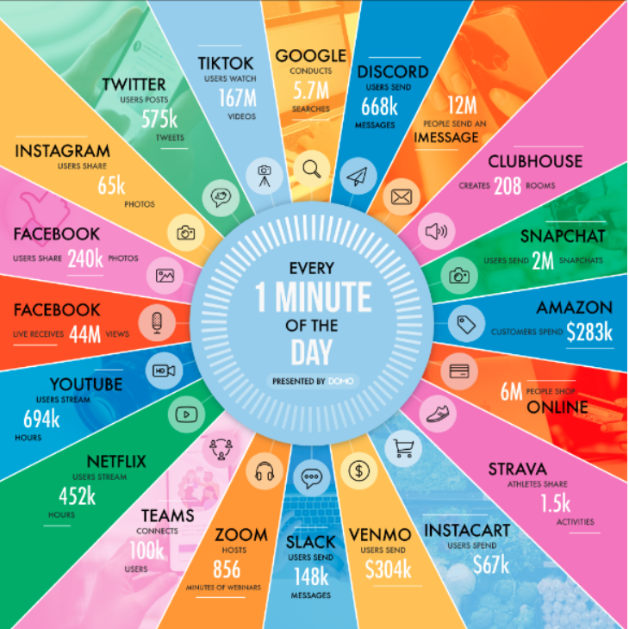
What will graph look like by end of 2022?
https://www.domo.com/learn/data-never-sleeps-8
https://www.domo.com/learn/infographic/data-never-sleeps-9

Slide 17
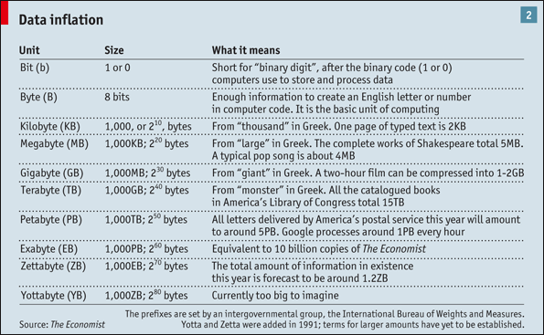
What are the implications of data volume?
SeaGate Storage
36 years to ship a zettabyte of storage (Mar 2015)
Shipped next by Mar 2019
Shipped 3rd by April 2021
Who will have the first Yottabyte of storage?

Slide 18
Why did we started using databases?
Tactical Advantages
Preserve data integrity - assurance that data is consistent, correct, and accessible
Eliminate data redundancy – unnecessary duplication of data that slows data processing and increases storage costs
Limit data view (query, report) so that users only see what they need to see, as cleanly and clearly as possible
Strategic Advantage
Connecting activities across the value chain!

Slide 19
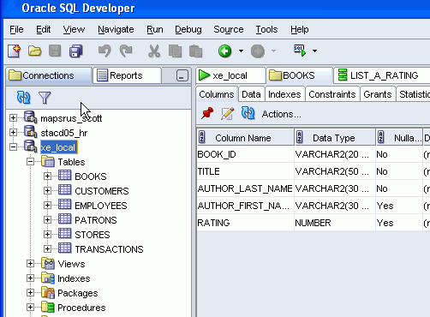

1. Data Integrity
Database field attributes allow designers to specify the type of information in a field
The database of a online store can require the credit card number field to be a 16 digit numeric required field—without 16 digits, a credit card number is of little value!

Slide 20
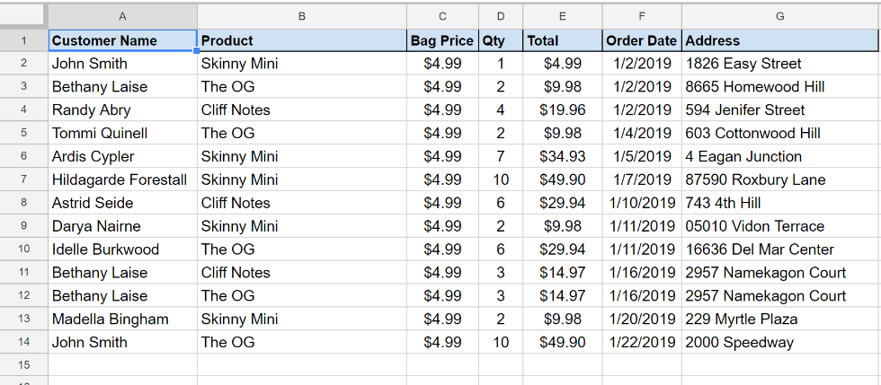
2. Reduce Redundancy
Redundancy makes data management harder for example:
Creating new record (e.g. Customer)
Reading is harder due to redundant data (e.g Count of Customers)
Update Customer Address or Product Price
Delete “Randy’s” Order means what?

Slide 21
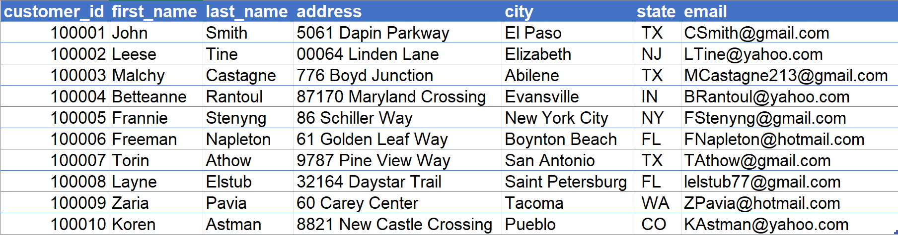
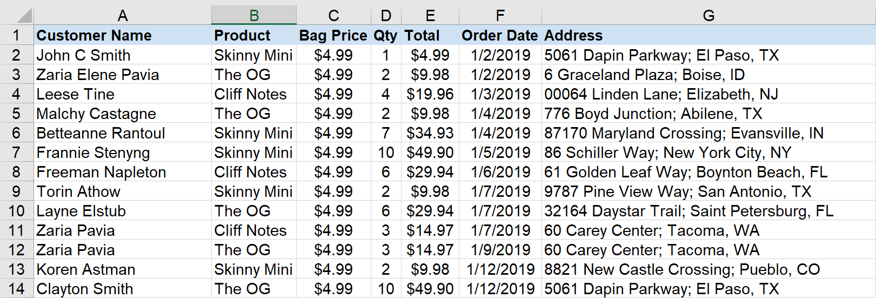
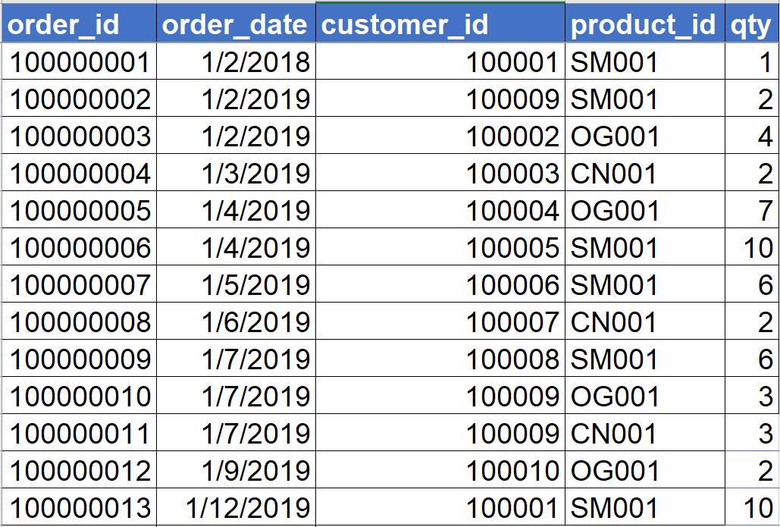
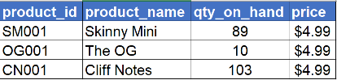
Database approach
Customers
Orders
Products

Slide 22
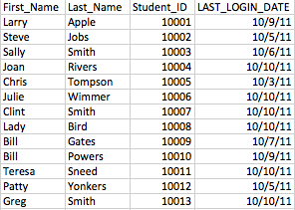
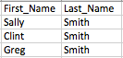
3. Limit and reduce the view of data
Queries “ask questions” of a database and pull records that meet certain criteria
SELECT first_name, last_name
FROM Records
WHERE last_name = ‘Smith’

Slide 23
Database Application
A database application is a collection of forms, reports, queries, and application programs that process data from a database
A database may have one or more applications, and each application may have one or more users
Applications have different purposes, features, and functions, but they all process the same inventory data stored in a common database

Slide 24




Users of multiple database applications
Order Entry Application
End Users
Purchasing Application
DBMS
Inventory Database
Procurement
Warehouse
Mgmt Application
Operations

Slide 25
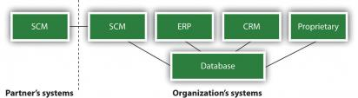
Enterprise IT + Database = $$$...
A firm’s database management system can be set up to work with several applications both within and outside the firm.
database = increased valued chain efficiency = more $$$...

Slide 26
What did Relational DB not do well?
Relational DBMS is great, but for a long time was not good at
managing time-series data
images, voice, video
2D, 3D data
documents (e.g., HTML, XML) or large text documents
User defined TYPES that allow inheritance, polymorphism and other O-O buzz-words..
Provide native object types (e.g., BLOB, CLOB) to manage unstructured data like video, images, ...

Slide 27
DB Evolution
Ali Davoudian, Liu Chen, and Mengchi Liu. 2018. A Survey on NoSQL Stores. ACMComput. Surv. 51, 2, Article 40 (April 2018), 43 pages.https://doi.org/10.1145/3158661

Slide 28

Typical Data Management Technology Ecosystem
SQL, Applications, Business Intelligence, Dashboards, …
Transactional Data (Relational)
Data Warehouse (Relational Normalized)
(Massively Parallel Processing—MPP)
Metadata (Relational)
Data Marts (Relational)
Business Processes
Reference Data (Relational)
External
Data
Data Lake
(Hybrid of tech)
Streaming Data (Non-Relational)
IoT Sensors
On device file storage
SAS, R, Python, MapReduce, Spark, Snowflake…
Notes:
What is a Data Lakehouse?
A data lakehouse is a new, open data management architecture that combines the flexibility, cost-efficiency, and scale of data lakes with the data management and ACID transactions of data warehouses, enabling business intelligence (BI) and machine learning (ML) on all data.

Slide 29
What’s next
Signup for Slack and download on devices
Go review the syllabus if you haven’t already
Readings are posted Modules. Read up to Day 2
Next class – 2 articles on canvas to pre-read
Complete Assignment #1
Prepare to work in teams and discuss in class
We want to promote active learning

Slide 30
Questions? Remember there are no stupid questions…except one 😉

